Slide 1
Cellular Mechanisms of Development

Slide 2
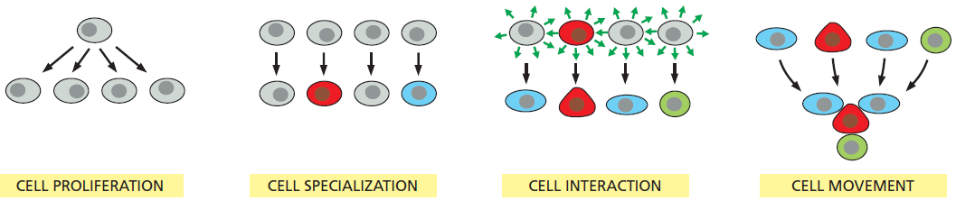
The four essential cell processes that allow a multicellular organism to be made

Slide 3
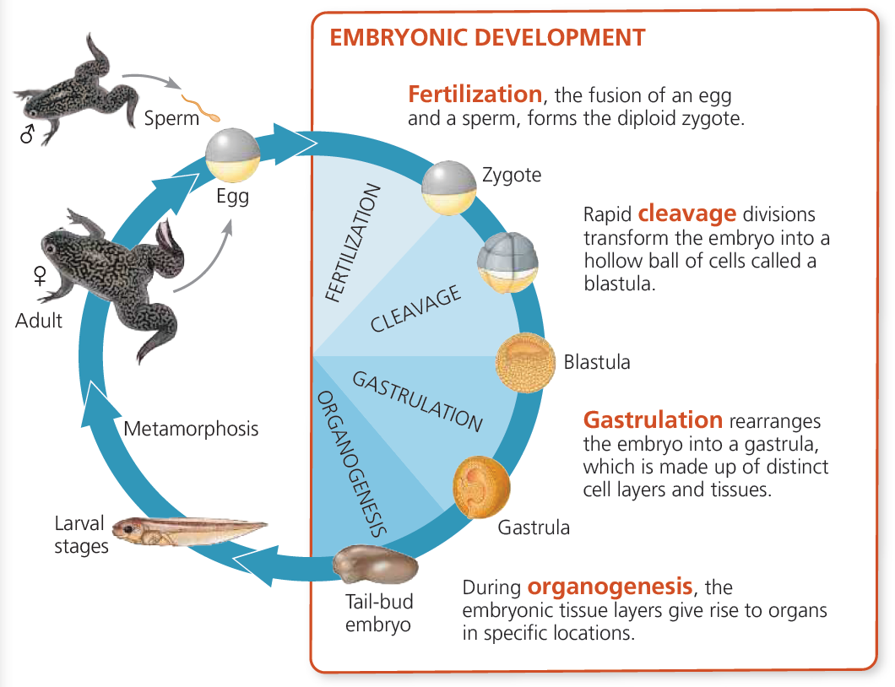
The early stages of development, as exemplified by a frog

Slide 4
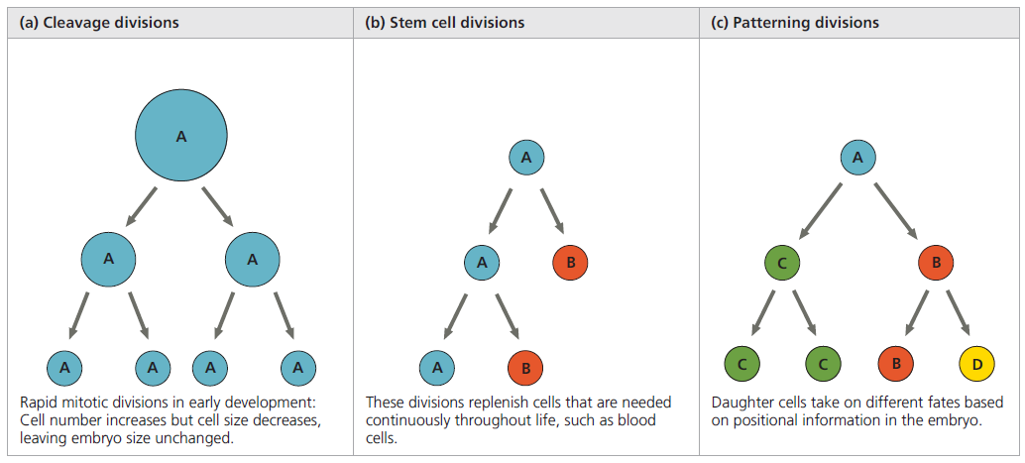
Variation in mitotic cell division in embryonic development

Slide 5
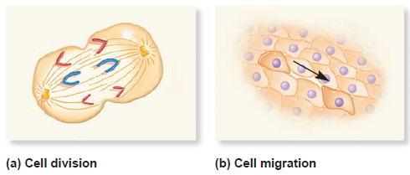
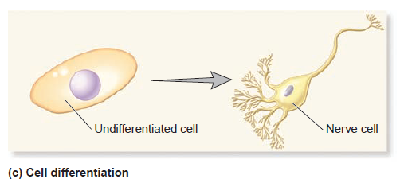
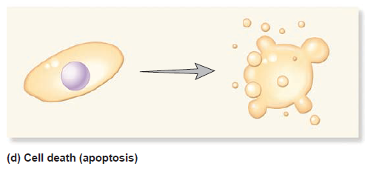
Four events that may happen to cells during the course of development

Slide 6
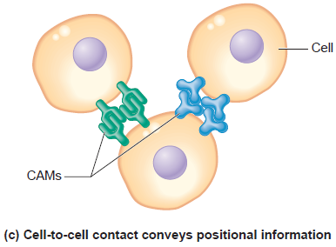
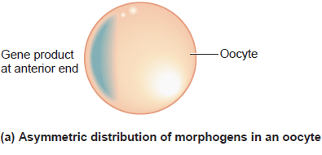
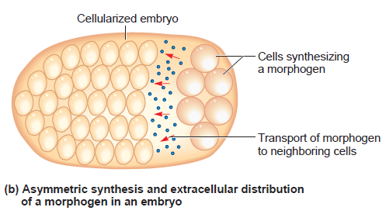
Three molecular mechanisms of positional information
The Generation of a Body Pattern Depends on the Positional Information That Each Cell Receives During Development

Slide 7
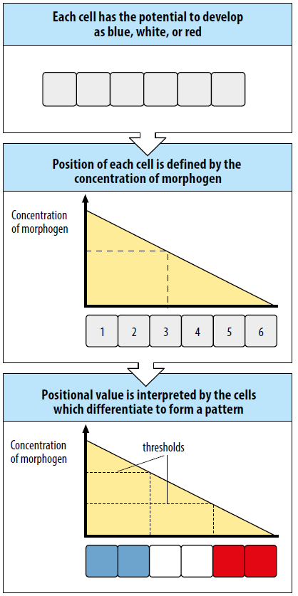
The French flag model of pattern formation

